Slide 1
COMP7305 Assignment Part III
Group 13: Mark Norris (3035766926), Lau Kai Chung (3035803970), Ng Ho Hin (3035754155), Ng Ka Hin (3035677175)

Slide 2
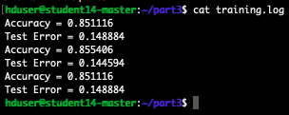
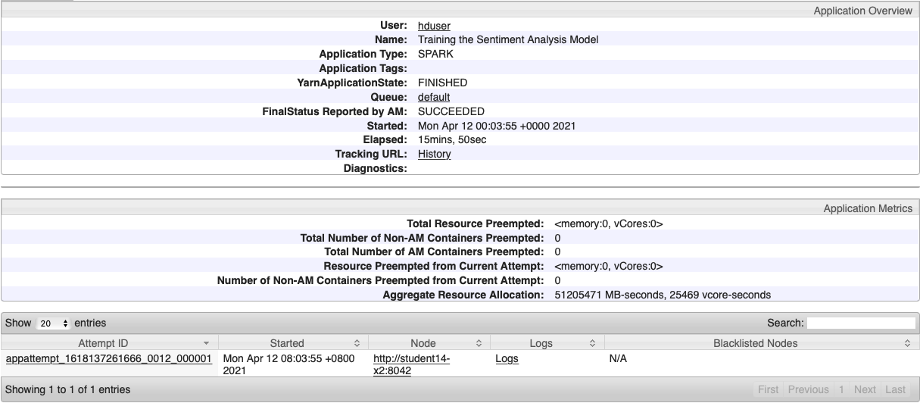
Part I: Train the Sentiment Analysis Model
Optimize the training time:

Slide 3
Spark Setting | Value | Discussion
spark.executor.instances | 26 | With executors having 2gb mem each, this will utilize all available memory on the cluster
spark.executor.cores | 1 | Set to 1 to better allow parallel running of executors as each node only has 2 vCPU
spark.executor.memory | 1600M | 2048 – overhead. Allow executors on all nodes including *-master nodes with only 2gb mem available
spark.driver.cores | 1 | Single core provided best results
spark.driver.memory | 1600M | Increased memory to driver to utilize all available on *-master node
spark.default.parallelism | 50 | Set to 50. This is ~2.5x the total number of vCPUs available in the cluster
spark.locality.wait | 5 | Allow 5 seconds to request a node local process
spark.speculation | True | Start a process on any node/rack. This process could be complete before local process has started/completed

Slide 4
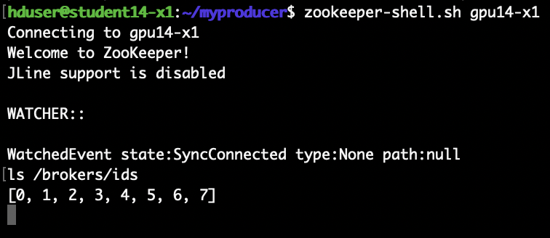
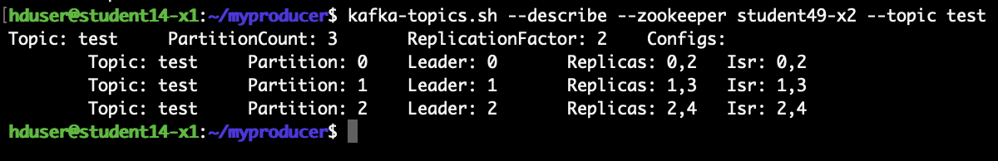
Part 2: Kafka Installation & Test
Q2: Kafka successfully installed and started
Q3: test topic details

Slide 5
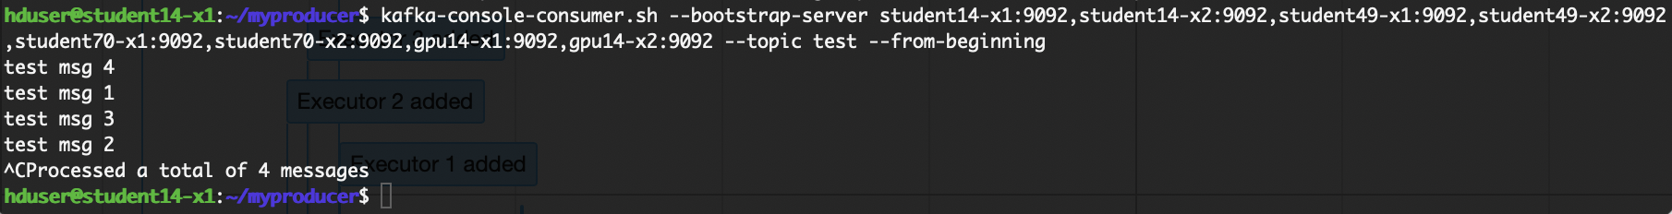
Q4: Console producer & consumer
Producer:
Consumer:
Why is the order of the 4 messages received by the consumer not the same as the order the producer sent them?

Slide 6
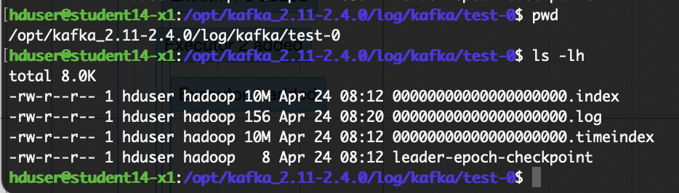
Single log file segment:
Contents of 000000xxx.log showing “test msg 1” and “test msg 3”:

Slide 7
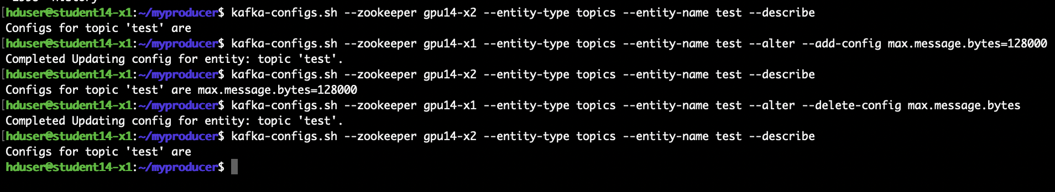
Q5:
Adding new topic configuration max.message.bytes=128000
Describing topic to show config added
Deleting config
Describing to show deleted

Slide 8
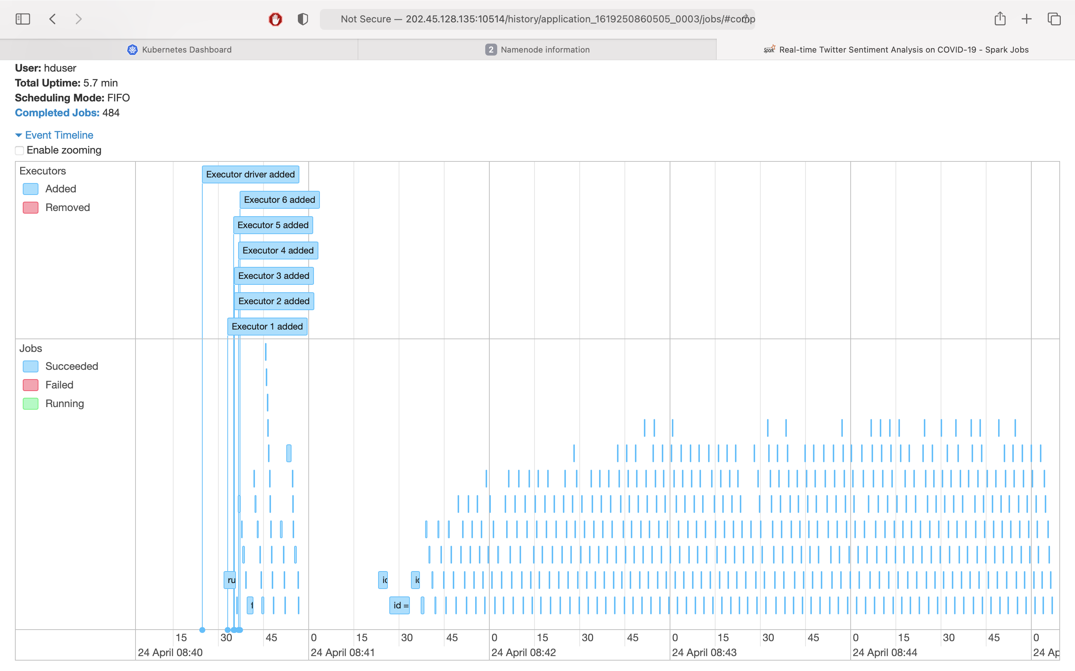
Part 3: Run the Real-time Sentiment Analysis Pipeline
Q6: Event timeline of jobs:
6 executors were created
450 jobs (excluding jobs in preparatory phase) were completed

Slide 9
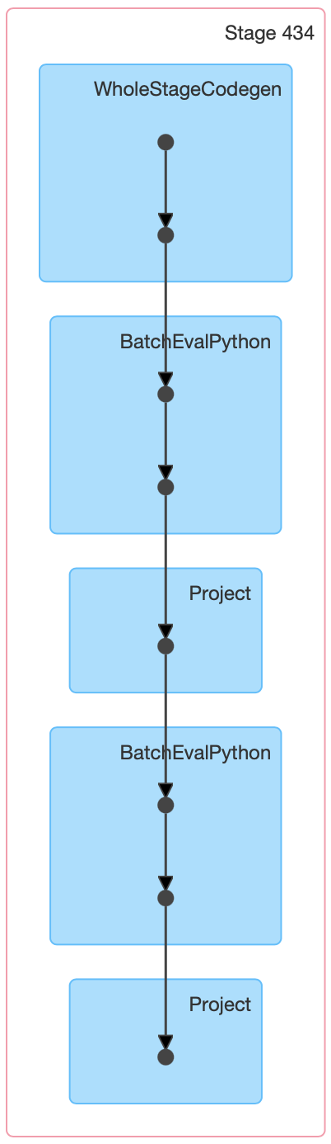
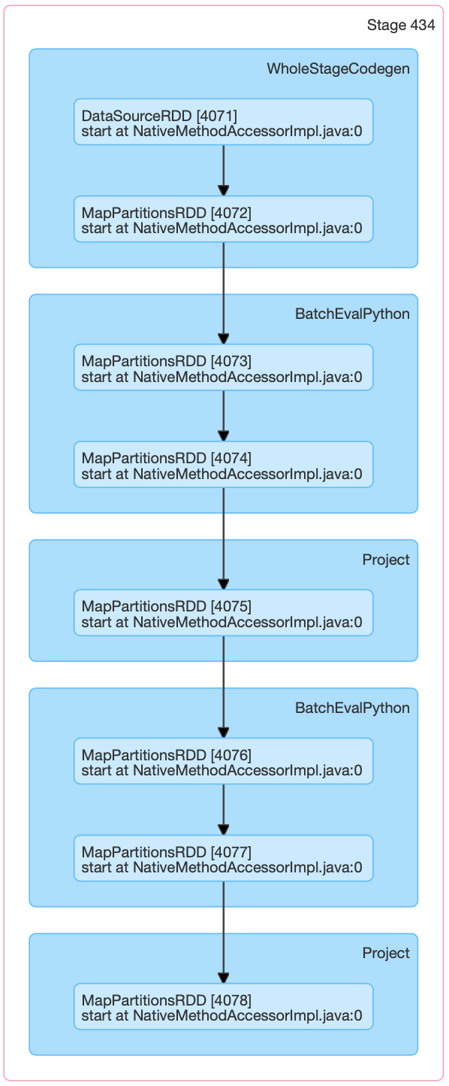
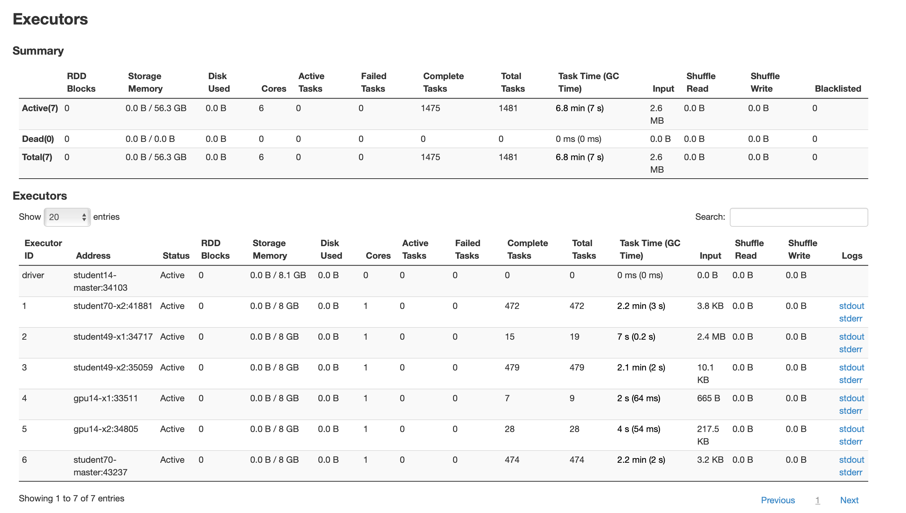
Q6 continued:
DAG Diagrams:
Executor tab shows all 6 executors are used to execute tasks:

Slide 10
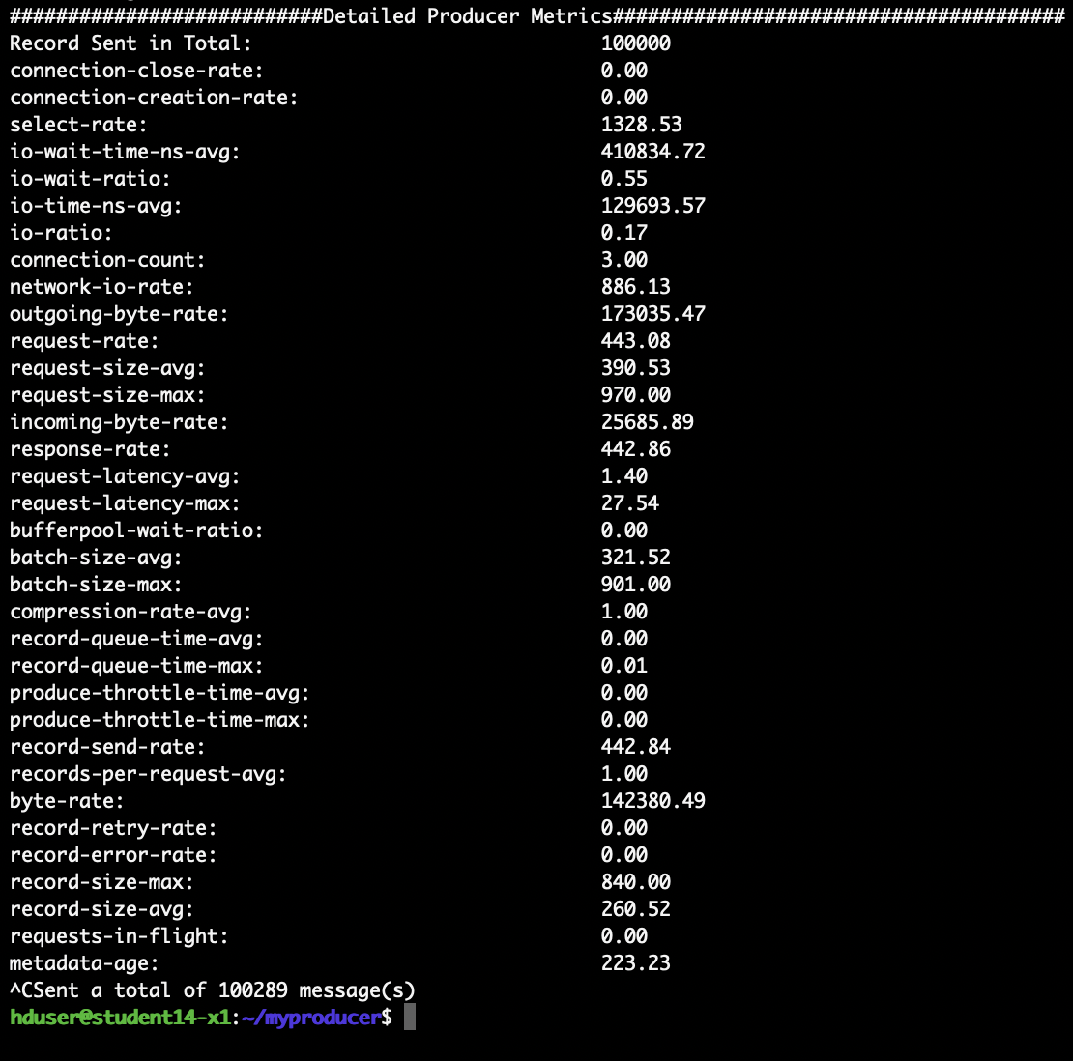
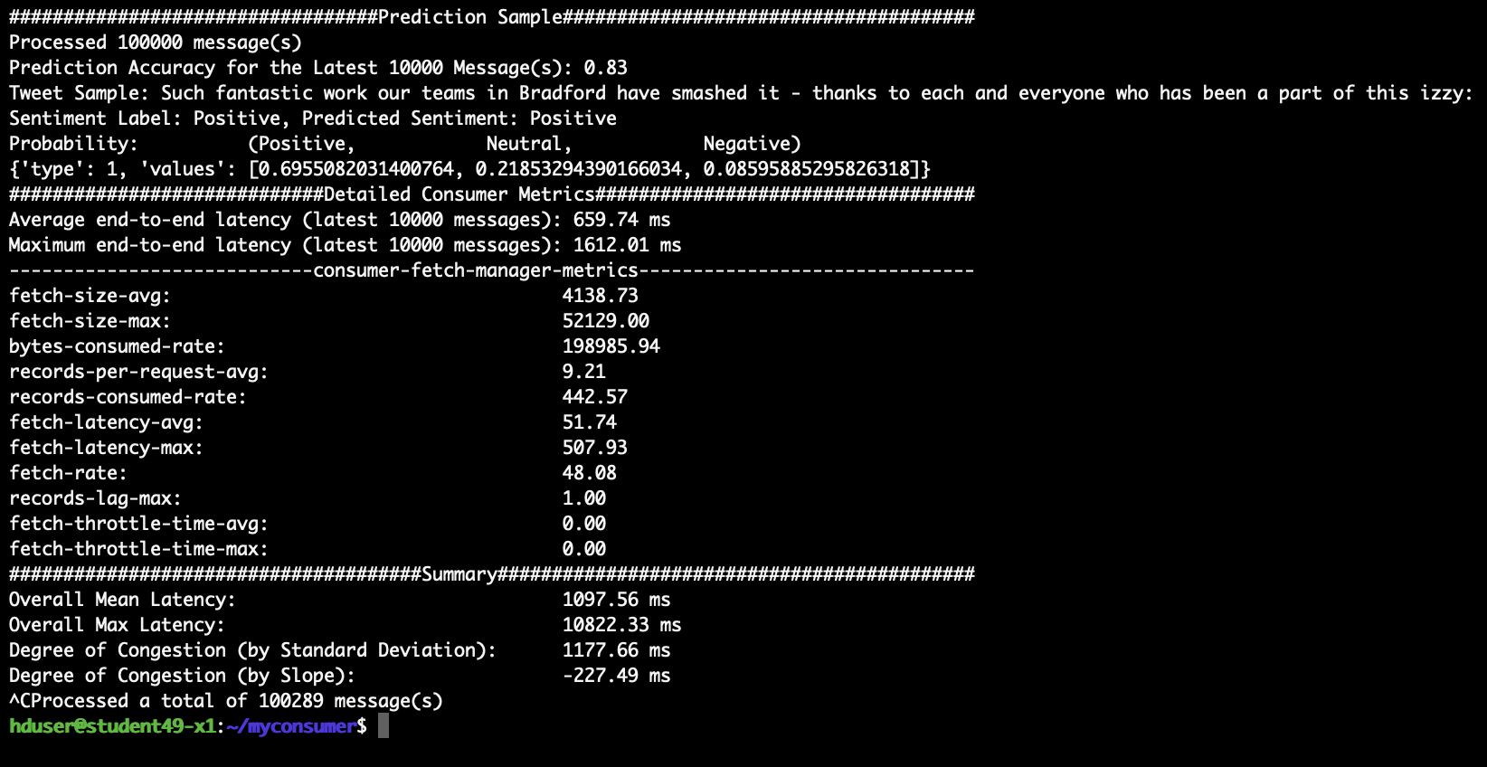
Q7:
Producer Report:
Consumer Report:

Slide 11
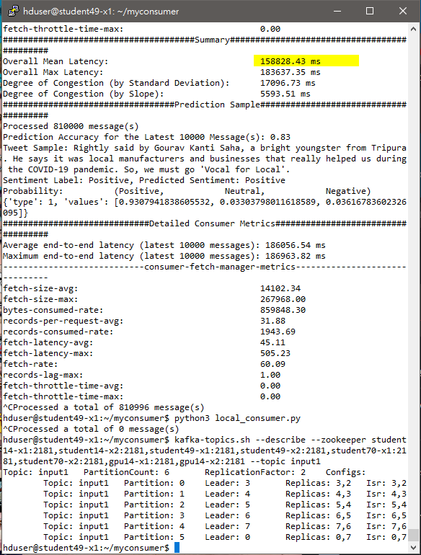
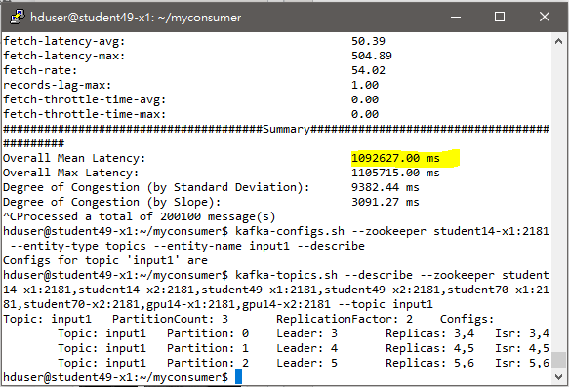
Q8
Both, for same reason – one partition can only serve one request at the same time, i.e., one core. So, the maximum task going on would always be limited by the number of partitions.
As for the mean latency, the config on 6 partitions are significantly lower (albeit with a slightly higher congestion slope) given the throughput from more partitions allow more I/O in processing the messages.

Slide 12
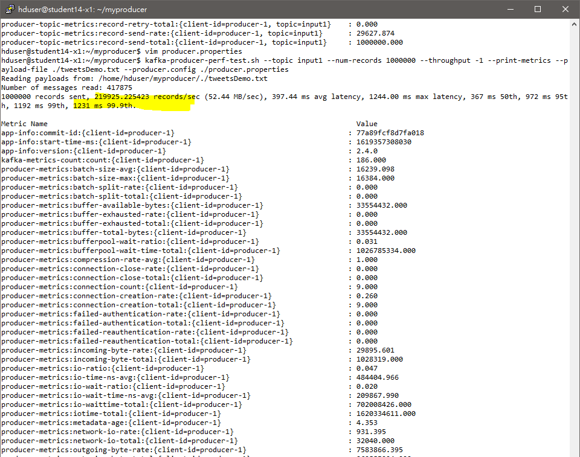
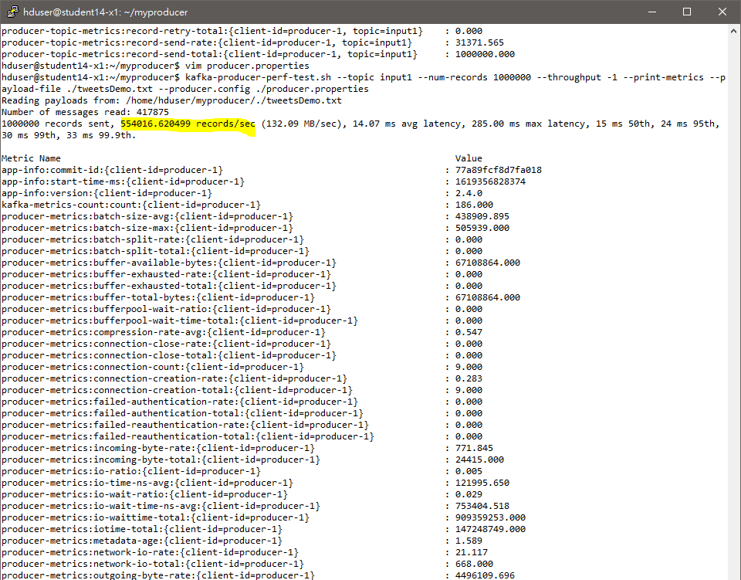
Q9
>550k run vs default run at 8 replica

Slide 13
Q9
From testing it looked like linger.ms, batch.size and compression.type must be tuned to achieve higher throughput.
All test configs below are based on 8 replicas to show incremental benefits. Test based on 3, 6 replica settings at default setting led to sub-200k throughput.
Config | Run 2 | Run 1 | Run 0 | Default
linger.ms | 5 | 5 | 0 | 0 | used along batch.size since only non-zero value allows us to take advantage of batches, but since 5 ms already allows us to reach request-size-max from metrics, no point to increase further
request.timeout.ms | 30000 | 30000 | 30000 | 30000
max.block.ms | 60000 | 60000 | 60000 | 60000
batch.size | 524288 | 524288 | 16384 | 16384 | 140K record, Large batch sizes regulates excess acks and handshaking process by sending in proper batches.
max.request.size | 1048576 | 1048576 | 1048576 | 1048576
buffer.memory | 64M | 64M | 64M | 32M | +30k record
compression.type | lz4 | none | none | none | +150K record, Computation power has better return on reducing I/O time instead of reducing latency.
Throughput | 555K | 389K | 250K | 220K

Slide 14
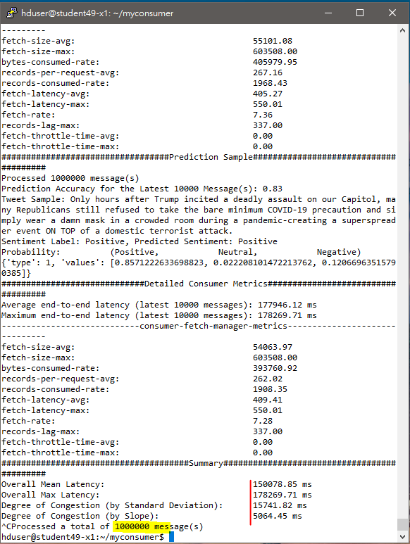
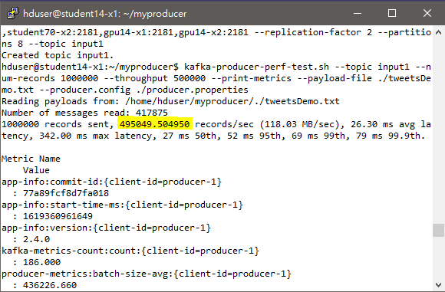
Q10
Partition: 8, Replica 2
Spark Executor 8, Core 2 Spark.locality.wait = 1
Min Fetch Byte size on both consumer and analyzer readStream= 1KB
Kafka Writer compression = lz4, linger.ms = 10, batch.size = 524,288

Slide 15
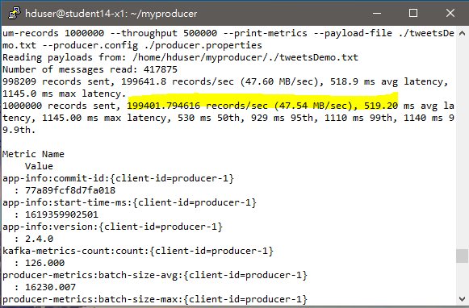
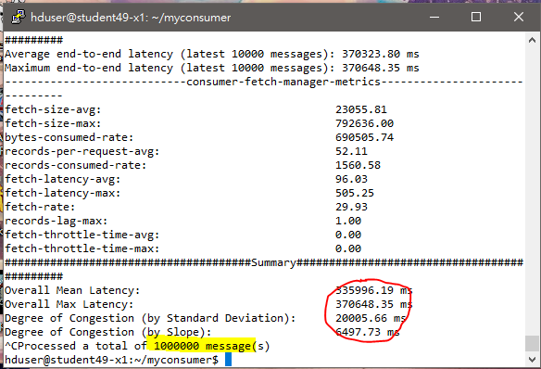
Q10
Default config (sub 200k throughput)

Slide 16
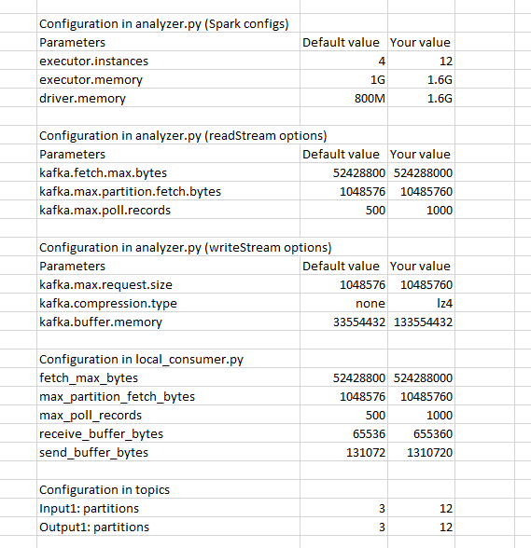

Slide 17
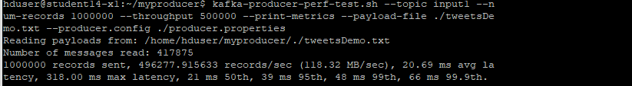
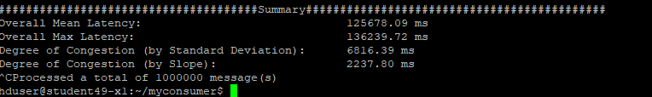
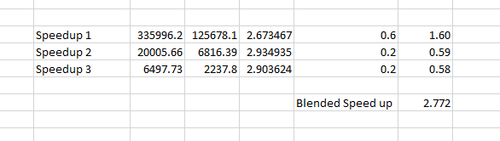

Slide 18
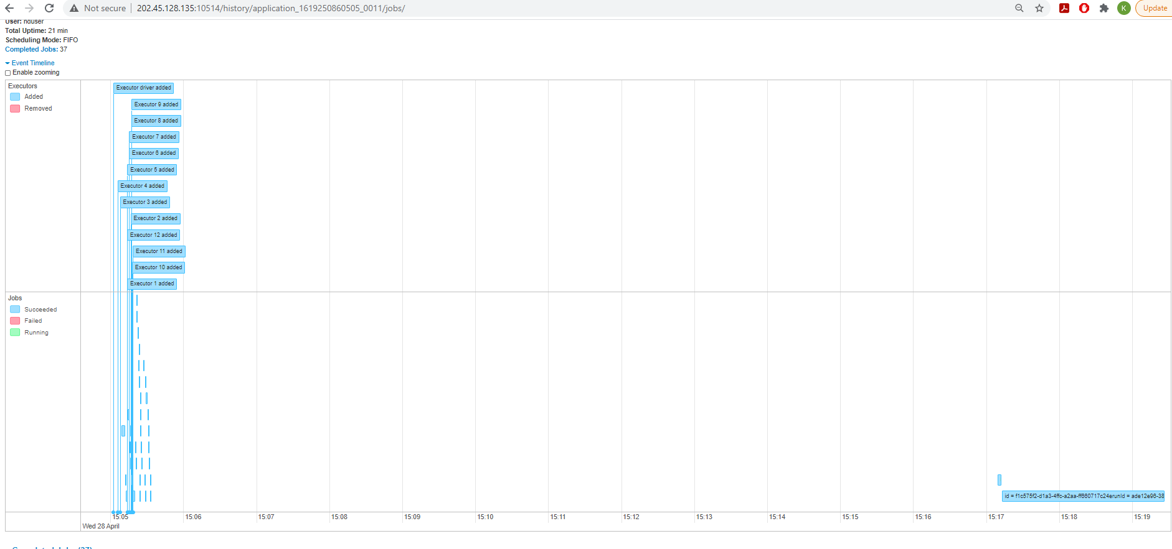

Slide 19
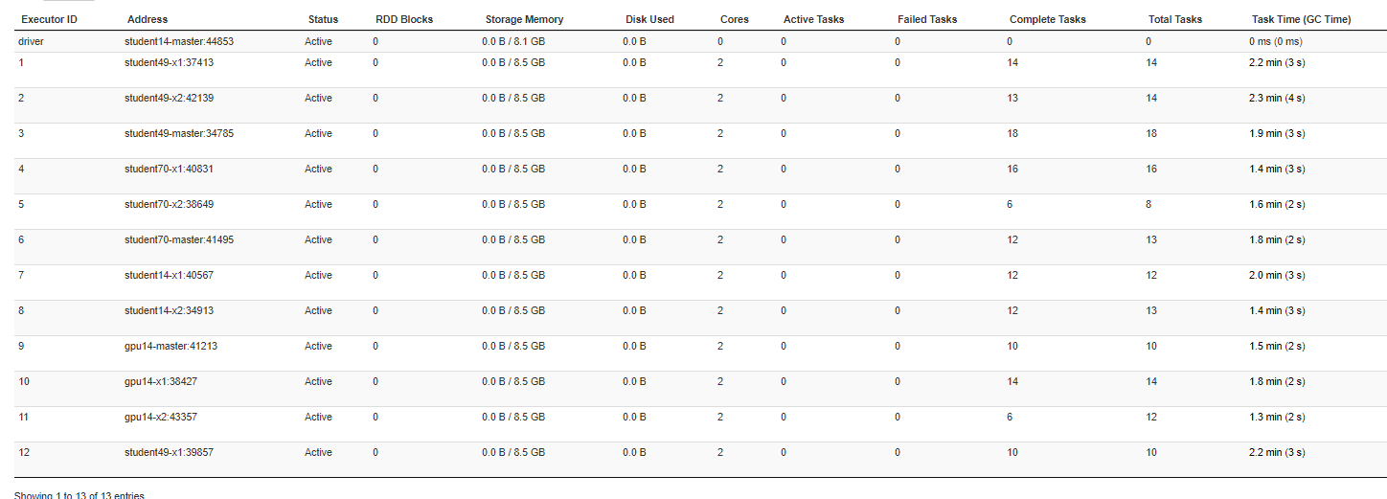

Slide 20
We see the Spark parameter and number of partition parameter to be the most critical in reduing the latency. We raise the executor instance to 12, VCPU to 2 for each instance, and executor memory to 1.6G to fully utilize every worker nodes we have. We also set the number of partition to 12 so that all the 12 executors can be working with no idle executors since every partition can only be read by 1 executor in the same consumer group.

Slide 21
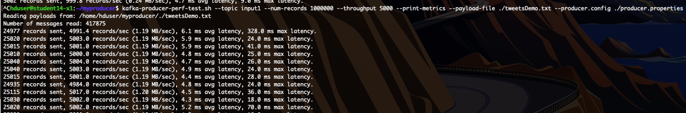

Q11: Task 3 in Chapter 7
Running kafka-producer-perf.sh showing throughput:
Screenshot of local_consumer.py summary:

Slide 22
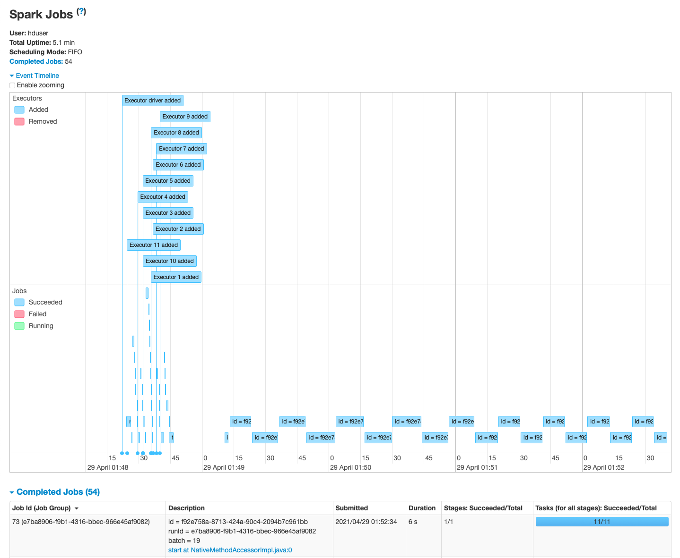
Event Timeline in jobs tab of Spark UI:
There are a greater number of jobs running (19 excluding the preparatory phase) as the throughput size is reduced by a factor of 100 from question 10 settings.

Slide 23
Demo video:
https://drive.google.com/file/d/1LtNWPoGvdj1r6yHpKOr1_6VE4q3K5oK_/view?usp=sharing

Slide 24
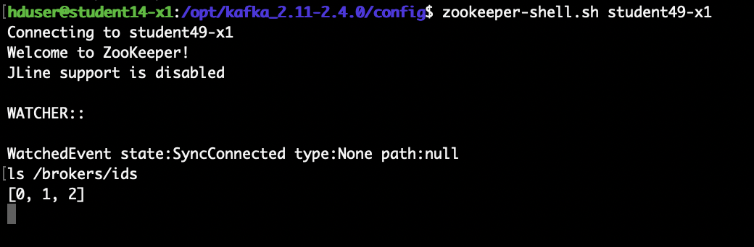
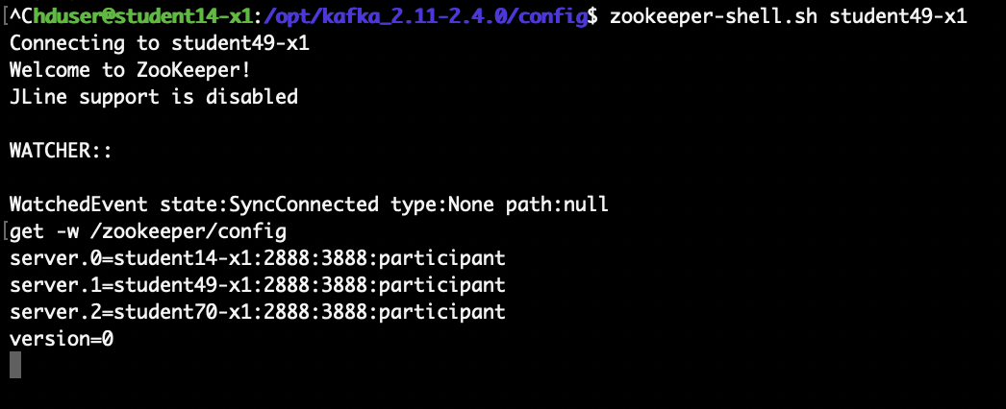
Q12: Final Task (Zookeeper)
Shows broker IDs of three brokers:
Result of get –w /zookeeper/config:

Slide 25
Troubleshooting
Analyzer.py was hanging; would not finish processing.
Issue was due to incorrect installation of several python packages and was resolved by removing all and re-installing with correct procedure

